Slide 1
Module 3 Cryptographic Mechanisms in Windows
Section 3 – Applications and uses of cryptography
June 2018

Slide 2
.
Part 1 – Disk and File Encryption
Learning Objectives
Understand the basic architecture of EFS and Bitlocker
Understand how Bitlocker achieve disk encryption
Understand the different Bitlocker protectors

Slide 3
Encrypted File System

Slide 4
Benfits of EFS
EFS allows users to store confidential information when people who have physical access to your computer could otherwise compromise that information
It is a component of the NTFS file system
EFS enables transparent encryption and decryption of files by using advanced, standard cryptographic algorithms.
EFS Encrypts files. Not Volumes.

Slide 5
How EFS works
EFS uses a public-private key pair and a per-file encryption key to encrypt and decrypt data. When a user encrypts a file, EFS generates a file encryption key (FEK) to encrypt the data. The FEK is encrypted with the user’s public key, and the encrypted FEK is then stored with the file.
Files can be marked for encryption in a variety of ways. The user can set the encryption attribute for a file by using Advanced Properties for the file in My Computer, storing the file in a file folder set for encryption, or by using the Cipher.exe command-line utility.
To decrypt files, the user opens the file, removes the encryption attribute, or decrypts the file by using the cipher.exe command-line utility. EFS decrypts the FEK by using the user’s private key, and then decrypts the data by using the FEK.

Slide 6
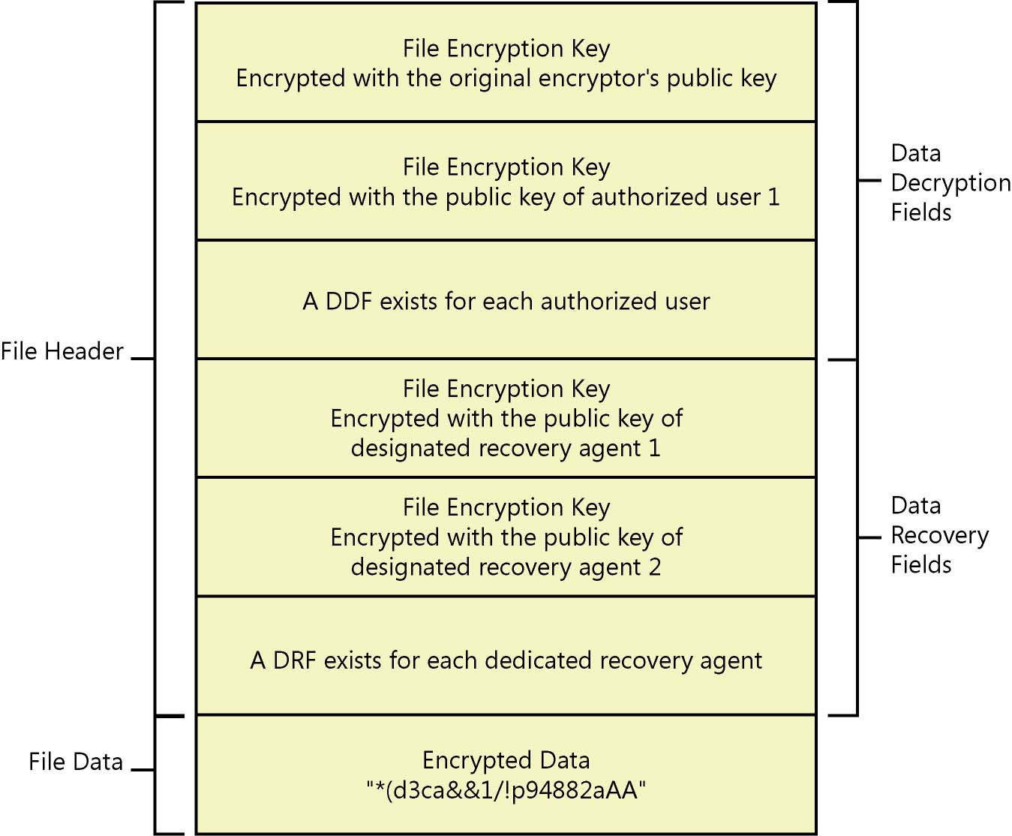
Structure of and Encrypted File
Data Encryption Field
An encrypted file contains a minimum of one stored FEK, the FEK encrypted by using the initial encryptor’s public key. The storage field for this encrypted FEK is called the data decryption field (DDF). Additionally, if an EFS-encrypted file is shared, a copy of the FEK is encrypted by using the newly authorized user’s public key, and the encrypted FEK is stored in another DDF.
Data Recovery Field
If a computer’s effective security policy designates one or more data recovery agent (DRA), copies of the FEK are encrypted for each DRA using each DRA’s public key and stored in another file header field called the data recovery field (DRF).

Slide 7
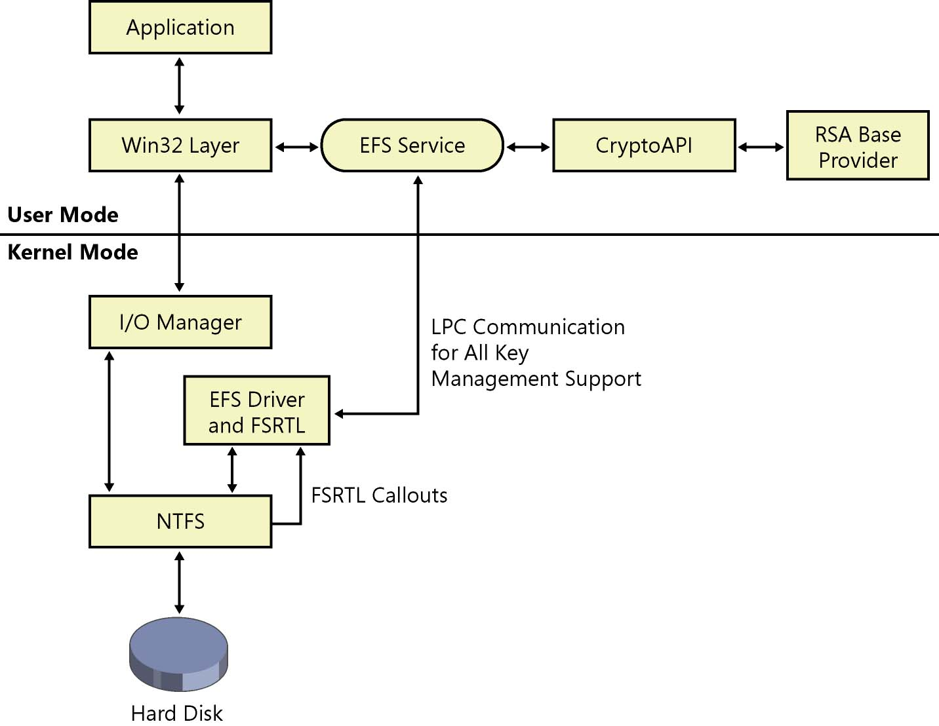
EFS Components
EFS Service
Part of LSASS. Calls CryptoAPI to acquire and decrypt the file encryption key (FEK) for a data file and sends it to the EFS driver.
EFS Driver
Tightly integrated with NTFS. The EFS driver is essentially a filter driver logically layered on top of NTFS. It communicates with the EFS service to request file encryption keys, DDFs, DRFs, and other key management services. It passes this information to the EFS FSRTL to perform various file system operations (open, read, write, and append) transparently.
CryptoAPI
EFS uses CryptoAPI for all of its cryptographic operations.
EFS FSRTL
The EFS FSRTL is a module within the EFS driver that implements NTFS callouts to handle various file system operations such as reads, writes, and opens on encrypted files and directories, and operations to encrypt, decrypt, and recover file data when it is written to or read from disk.

Slide 8
Encryption Process
The EFS service opens the file for exclusive access.
All data streams in the file are copied to a plaintext temporary file in the system’s temporary directory.
An FEK is randomly generated and used to encrypt the file
A DDF is created to contain the FEK encrypted by using the user’s public key. EFS automatically obtains the user’s public key from the user’s X.509 version 3 file encryption certificate.
If a recovery agent has been designated through Group Policy, a DRF is created to contain the FEK encrypted by using RSA and the recovery agent’s public key. EFS automatically obtains the recovery agent’s public key for file recovery from the recovery agent’s X.509 version 3 certificate, which is stored in the EFS recovery policy. If there are multiple recovery agents, a copy of the FEK is encrypted by using each agent’s public key, and a DRF is created to store each encrypted FEK.
EFS writes the encrypted data, along with the DDF and the DRF, back to the file. Because symmetric encryption does not add additional data, file size increase is minimal after encryption. The metadata, consisting primarily of encrypted FEKs, is usually less than one kilobyte. File size in bytes before and after encryption is normally reported to be the same.
The plaintext temporary file is deleted.

Slide 9
Decryption Process
NTFS recognizes that the file is encrypted and sends a request to the EFS driver.
The EFS driver retrieves the DDF and passes it to the EFS service.
The EFS service retrieves the user’s private key from the user’s profile and uses it to decrypt the DDF and obtain the FEK.
The EFS service passes the FEK back to the EFS driver.
The EFS driver uses the FEK to decrypt sections of the file as needed for the application.
Note When an application opens a file, only those sections of the file that the application is using are decrypted because EFS uses cipher block chaining. The behavior is different if the user removes the encryption attribute from the file. In this case, the entire file is decrypted and rewritten as plaintext.
The EFS driver returns the decrypted data to NTFS, which then sends the data to the requesting application.

Slide 10
EFS Encryption Algorithms
Windows Version | Default Algorithm
Windows 2000 | DESX
Windows XP | DESX
Windows XP SP1 | AES-256
Windows Server 2003 | AES-256
Windows Vista/2008 | AES-256
Windows 7/2008R2 and sup. | AES-256 ECC support for certificates

Slide 11
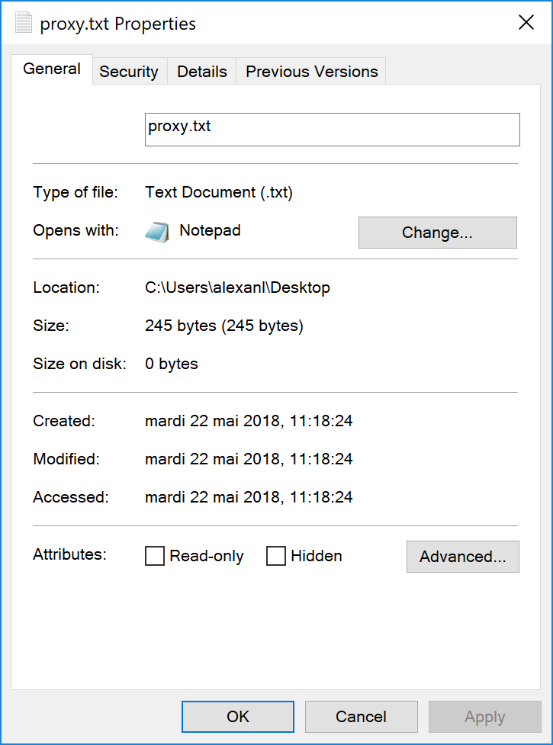
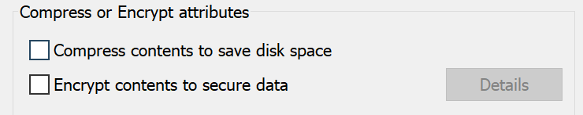
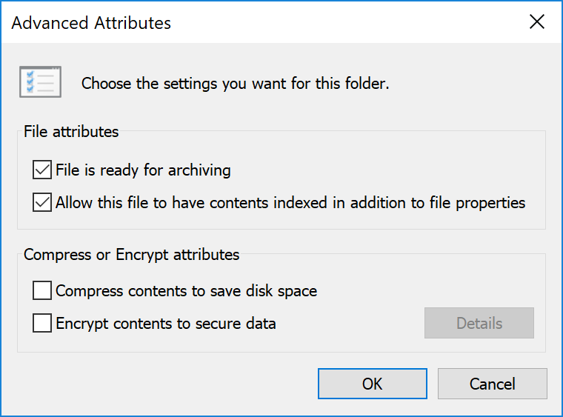
EFS User Interface

Slide 12
EFS and folders
EFS attribute can be set on folders
Folders are not encrypted. The attribute governs the behavior on files contained in the folder
File | Encryption Status
Already in the folder and its subfolders | If you have Write permission, file is encrypted and FEK is encrypted by using your public key; otherwise, files are unchanged.
Later created in or copied to the folder or subfolders by you | File is encrypted and FEK is encrypted by using your public key.
Later created in or copied to the folder or subfolders by another user | File is encrypted and FEK is encrypted by using the other user’s public key.
Later moved to the folder or subfolders | Moving unencrypted files into an encrypted folder will automatically encrypt those files in the new folder.

Slide 13
Bitlocker

Slide 14
Bitlocker Features
Full Volume Encryption technology
Integrated with Trusted Platform Module (TPM) technology for secure, tamper-resistant key protection
Can protect system drives, additional data drives, and removable USB/flash drives (including FAT)
Can provide boot environment verification to protect against tampering
Encrypts system files, including operating system (OS) files, pagefile, hibernation file, configuration, and more
Combinations of key protection: PIN, USB key, or TPM only
Offers multiple key-recovery alternatives, including backup to Active Directory, Azure Active Directory and recovery password
TPM Auto Provisioning
Support for Server and Server Class Storage Scenarios

Slide 15
Bitlocker History

Slide 16
Features appearing in Windows 8
BitLocker Provisioning
Windows 8 is now deployable to an encrypted state during installation prior to calling setup.
Used Disk Space Only Encryption
BitLocker now offers two encryption methods, Used Disk Space Only and Full volume encryption. Used Disk Space Only allows for a much quicker encryption experience by only encrypting used blocks on the targeted volume.
Standard User PIN and password change
Allows a standard user to change the BitLocker PIN or password on operating system volumes and the BitLocker password on data volumes, reducing internal help desk call volume.
Network Unlock
Enables a BitLocker system on a wired network to automatically unlock the system volume during boot (on capable Windows Server 2012 networks), reducing internal help desk call volumes for lost PINs.
Support for Self-Encrypted Hard Drives for Windows
Windows 8 includes BitLocker support for Self-Encrypted Hard Drives.

Slide 17
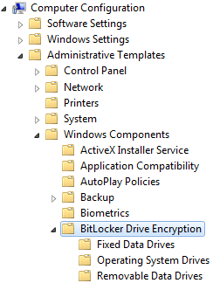
Bitlocker GPO Settings
Recommended way of managing Bitlocker is via Group Policy
However without GPO you can still take advantage of using Bitlocker
GPO has separate settings for:
OS drives
Fixed Data Drives
Removable Drives

Slide 18
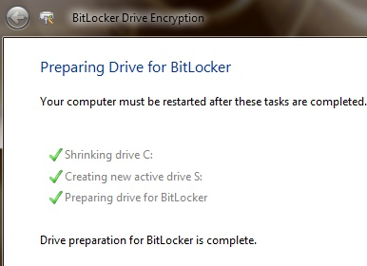
Bitlocker and the boot partition
Unencrypted, hidden partition which contains Boot Configuration Data (BCD) and boot files
Size:
Windows Vista: 1.5 GB
Windows 7: 100 MB
Windows 8 (BIOS): 350 MB
Windows 8 (UEFI): 100 MB
Windows 10 (BIOS): 450MB
Windows 10 (UEFI): 100 MB

Slide 19

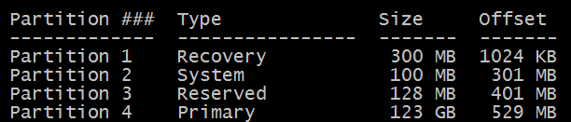
Windows EFI partition layout
Standard partition layout on EFI system containing
Optional Recovery Partition
EFI System Partition
Windows Installation partition

Slide 20
Devices supported by Bitlocker
Drive configuration | Supported | Not supported
Network | None | Network file system (NFS)
 |  | Distributed File System (DFS)
Optical media | None | CD file system (CDFS)
 |  | Live File System
 |  | Universal Disk Format (UDF)
Software | Basic volumes | Software-based RAID systems
 | Non Bootable virtual drives (VHDs) | Dynamic volumes
 | Bootable virtual disks (VHDs) (since Win 10 TH2) | RAM disks
File system | NTFS | CD File system
 | FAT16, FAT 32
 | ExFAT
Drive connection | USB, Firewire | Bluetooth
 | SATA. eSATA
 | SAS, ATA, IDE
 | FC
 | SCSI, iSCSI
Device type | Solid state drives, such as USB flash drives | None
 | Hardware-based RAID systems
 | Hard disk drive

Slide 21
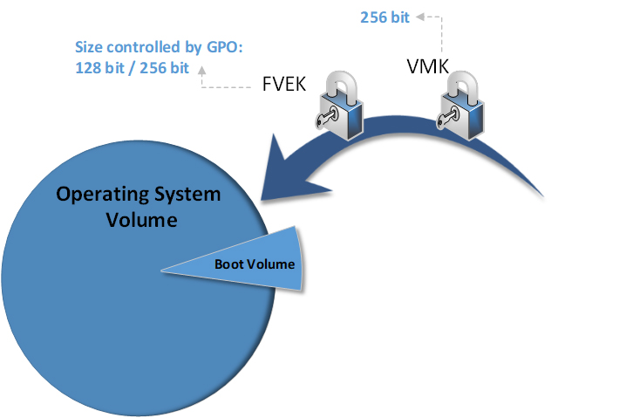
Bitlocker Keys
Bitlocker uses hierarchy of different keys:
FVEK – Full Volume Encryption Key
A key used to encrypt/decrypt disk sectors.
VMK – Volume Master Key
A key used to encrypt the FVEK
Protectors
A mechanism which
Has its own verification mechanism
Can decrypt the VMK
Protector
Operating System Volume contains:
Encrypted Operating System
Encrypted Page File
Encrypted Temp Files
Encrypted Data
Encrypted Hibernation File

Slide 22
Keys location
VBR
FVE
FVE
FVE
Bitlocker Protected Volume
VBR – Volume Boot Record
Contains mappings to the Bitlocker keys in 3 disk locations
These locations are placed at:
Beginning of the disk
Middle of the disk
End of the disk

Slide 23
List of Protectors and Recovery Methods

Slide 24
Protectors - TPM
TPM only – protects against stealing HDD from the machine. Provides Integrity checks.
TPM + PIN – adds pre-boot authentication (PBA)
PIN can consist of 4 to 20 characters
Minimum PIN length can be configured through Group Policy (Configure minimum PIN length for startup)
Enhanced PIN
Can consist from 4 to 20 alphanumeric characters
Must be enabled through Group Policy (Allow enhanced PINs for startup )

Slide 25
TPM Measured Boot
TPM measures boot process to determine if the computer has same values when it did the shut down
These values are held in the TPM’s Platform Configuration Register (PCR)
24 registers in the TPM. 15 of them are used by Windows and each holds one value
TPM checks at each start if the values have changed
If values changed while Protection is ON, TPM will not release the Encryption Key -> Computer enters Recovery Mode
Measured PCRs can be changed using Group Policy. This change will apply after next reboot.

Slide 26
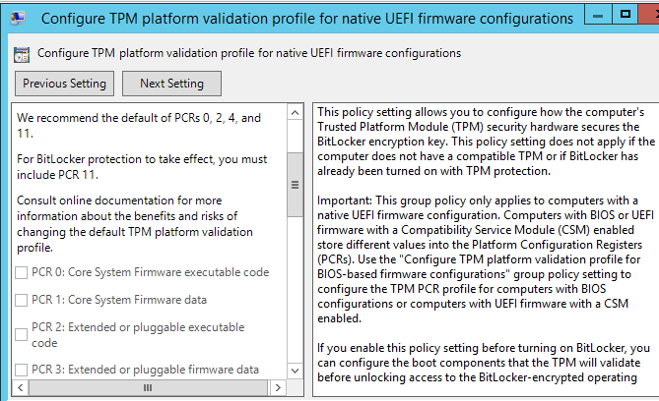
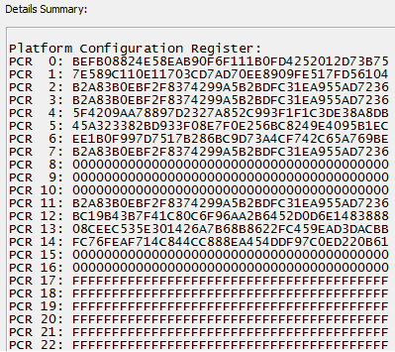
Controlling PCRs used by Bitlocker
Measured PCRs can be changed using Group Policy

Slide 27
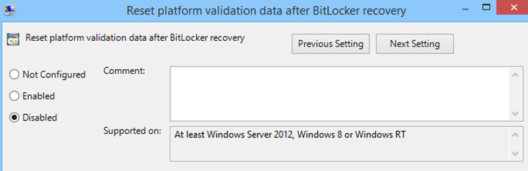
PCR Update
By default on Windows 8/2012 and above BitLocker will refresh the platform validation data after recovery so that after a recovery key is used to unlock a BitLocker-protected drive the PCR measurement is updated to reflect the current configuration of the computer.
However we can control this behaviour by GPO:
If you disable this policy, an administrator must manually accept boot-relevant configuration changes on a computer by first suspending and then resuming BitLocker protection (default behaviour on win7)

Slide 28
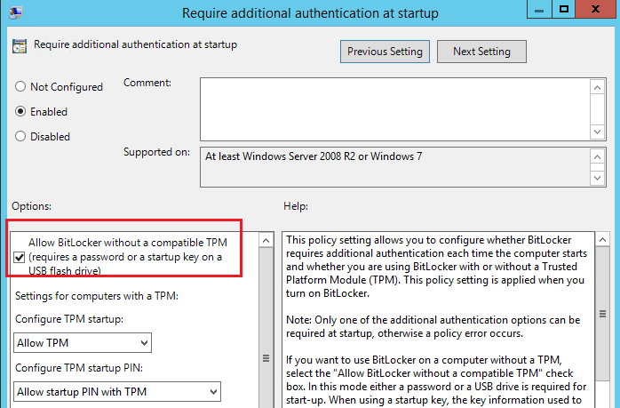
Bitlocker without TPM
BitLocker can be used without a TPM (not recommended)
“Require additional authentication at startup” GPO

Slide 29
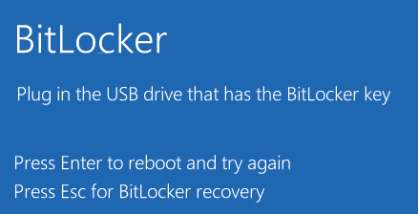
Protectors - USB Startup key
Startup Key
Key stored on USB flash drive
A Startup Key can be used when BitLocker is used without a TPM

Slide 30
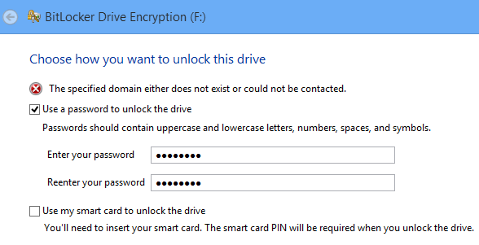
Protectors - Password
Password can be added to Fixed and removable data drives and starting from Windows 8 and later to OS drives
We can configure requirement for password complexity, however, domain controller has to be reachable in order to check domain password policies
Minimum password length is 8 characters.

Slide 31
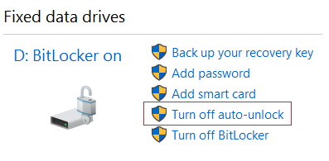
Protectors - Autounlock
Auto-unlock feature allows a user to access the data drives without entering the password every time. It works only while OS drive is encrypted.
Fixed data drives:
HKLM\SYSTEM\CurrentControlSet\Control\FVEAutoUnlock\*
Removable drives:
HKCU\Software\Microsoft\Windows\CurrentVersion\FveAutoUnlock\*
Keys are bound to specific user/computer so we cannot copy them to another machine and allow access.

Slide 32
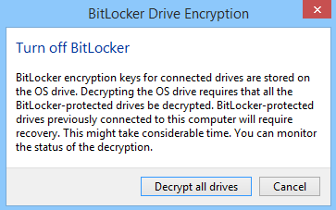
Protectors - Autounlock
If you want to disable BitLocker on C: drive – system will warn you that all drives that are using auto-unlock need to be decrypted :
You can also use manage-bde –autounlock –ClearAllKeys C: to delete auto-unlock keys from registry

Slide 33
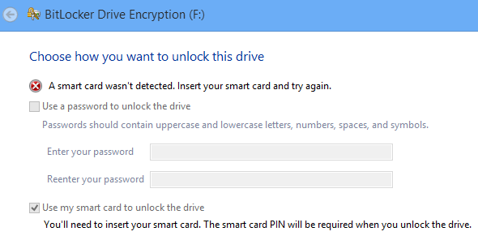
Protectors - Smartcard
Also certificates located on the smart cards containing default OID (or custom OID defined in GPO) can be used as protectors. Default OID=1.3.6.1.4.1.311.67.1.1)
Smart cards can be only used with fixed and removable data drives (not OS)
Self signed certs can be also used (HKLM\Software\Policies\Microsoft\FVE: DWORD value SelfSignedCertificates=1)

Slide 34
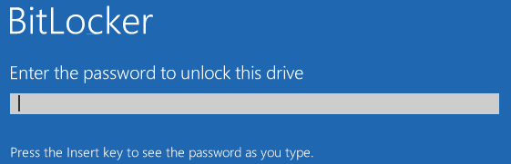
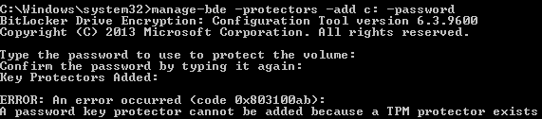
Protectors - Password Only for OS
Has been added since Windows 8
Allows to do PBA without TPM+PIN method
Works in similar fashion as password for data drives
Usually seen on Windows To Go Devices (since, cannot roam the TPM Device)
Password cannot be added while TPM protector exists on volume

Slide 35
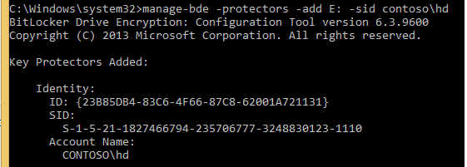
Protectors - Sid
SID-Based protector can use: AD User, Computer or Group SID to unlock the drive
Drive will be unlocked when user logs on to the system
Only works for Data and Removable Data Drives (for OS only if u connect as secondary drive)

Slide 36
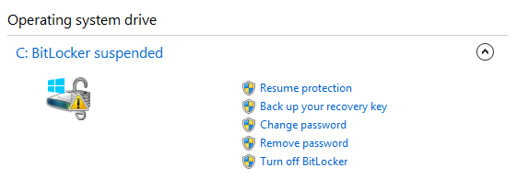
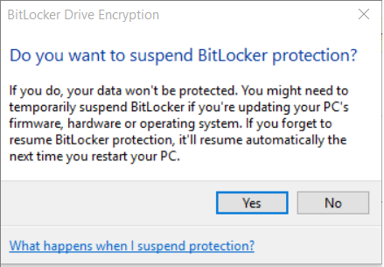
Protectors - Clear Key
The clear key is an unprotected 256-bit key stored on the volume to decrypt the VMK.
It is used when
the encrypted volume is being decrypted.
protection is suspended
cannot be added manually or listed

Slide 37
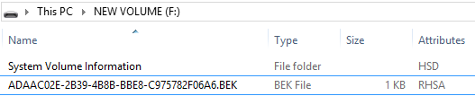
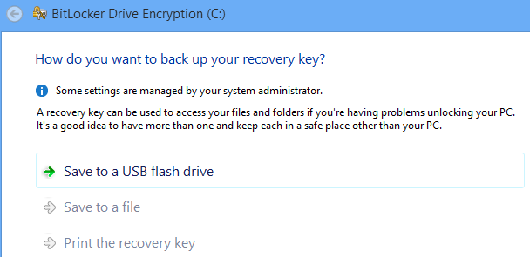
Recovery Methods - Recovery USB Key
Key file present on a removable storage device
Must be present during recovery
1 KB file with system and hidden attributes, name cannot be changed

Slide 38
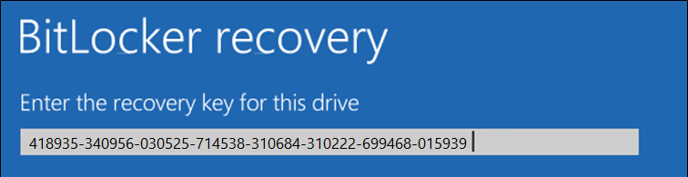
Recovery Methods - Recovery Password
48 digits divided in eight blocks
Every group is dividable by 11 with a remainder of 0.
You can store recovery password:
Saved as a file
Printed form
Microsoft OneDrive
Active Directory Domain Services (AD DS)
Azure Active Directory
Microsoft BitLocker Administration and Monitoring (MBAM) Database
Must be typed in the BitLocker recovery console
Can have multiple Recovery Keys for one volume

Slide 39
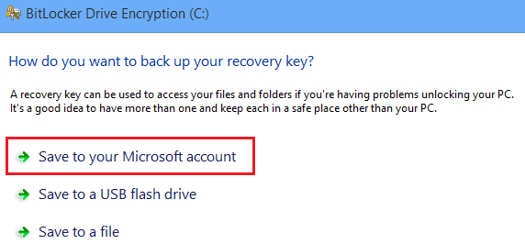
Recovery Password on Microsoft Account
When logged on to Windows 8 / Windows 8.1 with Microsoft account you may want to save your recovery password to OneDrive (formerly known as SkyDrive).

Slide 40
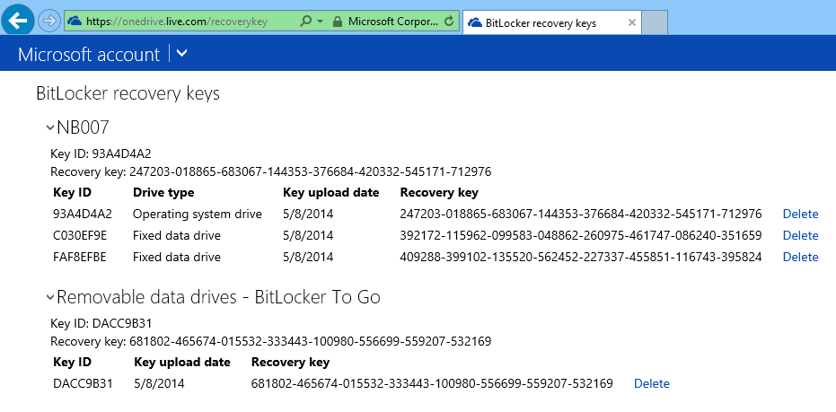
This password will not be visible in standard OneDrive documents view. You need to go to https://onedrive.live.com/recoverykey

Slide 41
Network Unlock
Enables a BitLocker system on a wired network to automatically unlock the system volume during boot. Example: The PIN does not need to be supplied
The requirement to enter a PIN can make it difficult for enterprises to install software patches to unattended desktops and servers
Network Unlock works in a similar fashion to the TPM+Startup Key at boot. Rather than needing to read the Startup Key from USB media, however, the key for Network unlock is composed from a key stored in the TPM and an encrypted network key that is sent to the server, decrypted and returned to the client in a secure session.

Slide 42
Support for Encrypted Hard Drives for Windows
Windows 8 BitLocker also provides support for a new enhanced storage device type, the Encrypted Hard Drive, which is becoming a more common option in new servers and computers
Encrypted Hard Drives offer Full Disk Encryption (FDE), which means encryption occurs on each block of the physical drive. Encryption operations are more efficient on Encrypted Hard Drives because the encryption process is offloaded to the storage controller on the drive (also known as hardware-based encryption)

Slide 43
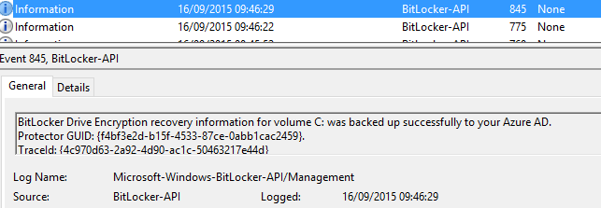
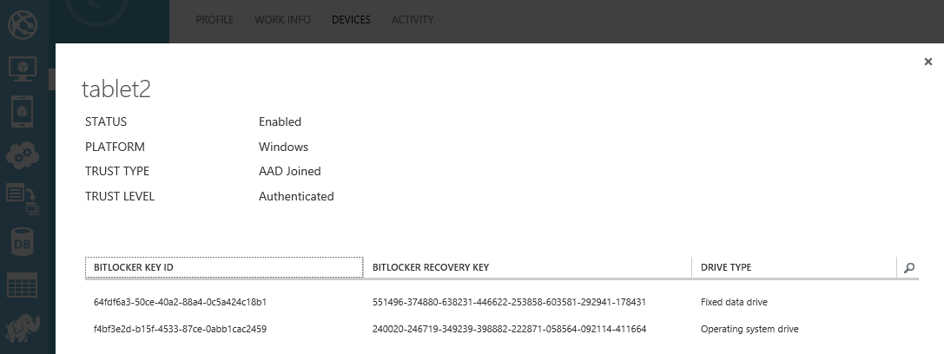
Windows 10 will automatically export Bitlocker Recovery Password after joining to Azure AD
Event ID 845 will be logged as confirmation
Keys can be retrieved from Azure Portal

Slide 44
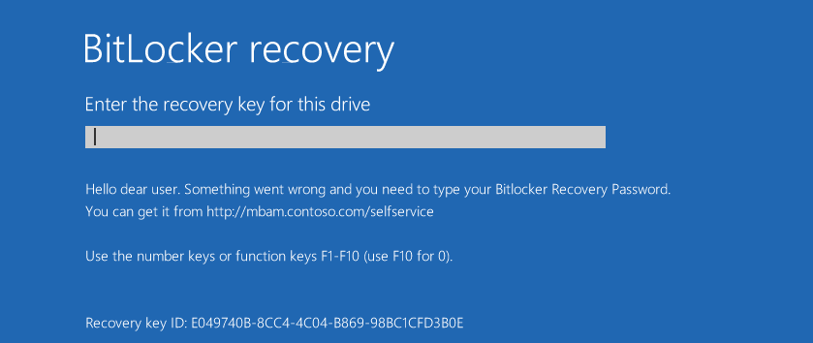
In Windows 7/8 user is asked to use general link: http://windows.microsoft.com/recoverykeyfaq
Windows 10 gives you ability to customize message text and/or link on Recovery Screen
It is fully controlled by GPO

Slide 45
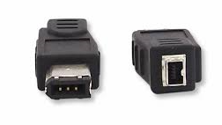
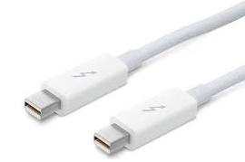
Better protection of DMA ports
DMA ports are only activated when user log on to the machine
FireWire
Thunderbolt
If the user locks the workstation and connects new device via DMA interface - device will only be activated when user logs on

Slide 46
Brute Force attacks and countermeasures
Against PIN
Countermeasure: TPM anti-hammering logic, Enhanced PIN via GPO
Against Password Protector
Countermeasure: require complex Bitlocker passwords via GPO
Against Recovery Key
Countermeasure: long 48 digit key which would take 580 000 years to guess (assuming 1 million guesses per second)
Against user logon credentials
Countermeasure: password policies, account lockout threshold, automatic restart and recovery mode after X number of tries (win8)

Slide 47
DMA attacks and countermeasures
Direct Memory Access (DMA) interface allows certain hardware devices to communicate directly with a system memory (RAM)
It doesn’t require any authentication
Examples: FireWire, Thunderbolt, Express Card, PCMCI, PCI, PCI-X, PCI-Express
Attacker connects PC or device with memory analyzer and tries to locate encryption keys
Countermeasures:
Disable external DMA interfaces in BIOS or via Windows (GPO)
Increase physical security to protect expansion slots (PCI, PCI-Express)
Use PBA (pre-boot authentication)

Slide 48
.
Part 2 – Encryption of Communications
Learning Objectives
Understand how SChannel works
Understand how to configure SChannel policies
Understand the security concerns around the SMB protocol

Slide 49
SChannel

Slide 50
SChannel
Schannel – Secure Channel is Microsoft’s implementation of the SSL/TLS protocols
The SSL & TLS protocols provide communications security over the Internet.
The protocol allows client/server applications to communicate in a way that is designed to prevent eavesdropping, tampering, or message forgery.

Slide 51
SSL/TLS Protocol
Cryptographic protocols that provide communications security over a computer network
Acts on top of TCP or UDP
Aims primarily to provide privacy and data integrity between two or more communicating computer applications

Slide 52
SSL/TLS History
SSL 1.0
Never Published. Unreliable – should not be used anymore
SSL 2.0
1995 – Developped by Netscape. Several security flaws. Unreliable – should not be used anymore
SSL 3.0
1996 – RFC 6101. Unreliable – should not be used anymore
TLS 1.0
1999 – RFC 2246. Unreliable – should not be used anymore
TLS 1.1
2006 – RFC 4346. Unreliable – should not be used anymore
TLS 1.2
2008 – RFC 5246. Recommended version
TLS 1.3
2018 – Internet Draft https://datatracker.ietf.org/doc/draft-ietf-tls-tls13/

Slide 53
TLS Protocol
TLS Record Protocol
Sits on top of TCP or UDP
Provides secure data transport
The connection is private. Symmetric cryptography is used for data encryption (keys negotiated by the Handshake protocol)
The connection is reliable. Message transport includes a message integrity check using a keyed MAC
TLS Handshake protocol
Encapsulated inside the Record Protocol
Establish initial security association
The peer's identity can be authenticated using asymmetric, or public key cryptography
The negotiation of a shared secret for data encryption is secure: the negotiated secret is unavailable to eavesdropper
The negotiation is reliable: no attacker can modify the negotiation communication without being detected
TCP/UDP
TLS Record Protocol
TLS Handshake Protocol
Applications Data

Slide 54
TLS Protocols support in Windows
Windows OS | TLS 1.0 Client | TLS 1.0 Server | TLS 1.1 Client | TLS 1.1 Server | TLS 1.2 Client | TLS 1.2 Server
Windows Vista/Windows Server 2008 | Enabled | Enabled | Not supported | Not supported | Not supported | Not supported
Windows Server 2008 with Service Pack 2 (SP2) | Enabled | Enabled | Disabled | Disabled | Disabled | Disabled
Windows 7/Windows Server 2008 R2 | Enabled | Enabled | Disabled | Disabled | Disabled | Disabled
Windows 8/Windows Server 2012 | Enabled | Enabled | Enabled | Enabled | Enabled | Enabled
Windows 8.1/Windows Server 2012 R2 | Enabled | Enabled | Enabled | Enabled | Enabled | Enabled
Windows 10, version 1507 | Enabled | Enabled | Enabled | Enabled | Enabled | Enabled
Windows 10, version 1511 | Enabled | Enabled | Enabled | Enabled | Enabled | Enabled
Windows 10, version 1607/Windows Server 2016 Standard | Enabled | Enabled | Enabled | Enabled | Enabled | Enabled
Windows 10, version 1703 | Enabled | Enabled | Enabled | Enabled | Enabled | Enabled

Slide 55
DTLS protocols support in Windows
Windows OS | DTLS 1.0 Client | DTLS 1.0 Server | DTLS 1.2 Client | DTLS 1.2 Server
Windows Vista/Windows Server 2008 | Not supported | Not supported | Not supported | Not supported
Windows Server 2008 with SP2 | Not supported | Not supported | Not supported | Not supported
Windows 7/Windows Server 2008 R2 | Enabled | Enabled | Not supported | Not supported
Windows 8/Windows Server 2012 | Enabled | Enabled | Not supported | Not supported
Windows 8.1/Windows Server 2012 R2 | Enabled | Enabled | Not supported | Not supported
Windows 10, version 1507 | Enabled | Enabled | Not supported | Not supported
Windows 10, version 1511 | Enabled | Enabled | Not supported | Not supported
Windows 10, version 1607/Windows Server 2016 Standard | Enabled | Enabled | Enabled | Enabled
Windows 10, version 1703 | Enabled | Enabled | Enabled | Enabled

Slide 56
pre-TLS protocols support in Windows
Windows OS | PCT 1.0 | SSL2 Client | SSL2 Server | SSL3 Client | SSL3 Server
Windows Vista/Windows Server 2008 | Not supported | Disabled | Enabled | Enabled | Enabled
Windows Server 2008 with SP2 | Not supported | Disabled | Enabled | Enabled | Enabled
Windows 7/Windows Server 2008 R2 | Not supported | Disabled | Enabled | Enabled | Enabled
Windows 8/Windows Server 2012 | Not supported | Disabled | Disabled | Enabled | Enabled
Windows 8.1/Windows Server 2012 R2 | Not supported | Disabled | Disabled | Enabled | Enabled
Windows 10, version 1507 | Not supported | Disabled | Disabled | Enabled | Enabled
Windows 10, version 1511 | Not supported | Disabled | Disabled | Enabled | Enabled
Windows 10, version 1607/Windows Server 2016 Standard | Not supported | Not supported | Not supported | Disabled | Disabled
Windows 10, version 1703 | Not supported | Not supported | Not supported | Disabled | Disabled

Slide 57
Establishing a Secure Session by Using TLS
The client sends a "Client hello" message to the server, along with the client's random value and supported cipher suites.
The server responds by sending a "Server hello" message to the client, along with the server's random value.
The server sends its certificate to the client for authentication and may request a certificate from the client. The server sends the "Server hello done" message.
If the server has requested a certificate from the client, the client sends it.
The client creates a random Pre-Master Secret and encrypts it with the public key from the server's certificate, sending the encrypted Pre-Master Secret to the server.
The server receives the Pre-Master Secret. The server and client each generate the Master Secret and session keys based on the Pre-Master Secret.
The client sends "Change cipher spec" notification to server to indicate that the client will start using the new session keys for hashing and encrypting messages. Client also sends "Client finished" message.
Server receives "Change cipher spec" and switches its record layer security state to symmetric encryption using the session keys. Server sends "Server finished" message to the client.
Client and server can now exchange application data over the secured channel they have established. All messages sent from client to server and from server to client are encrypted using session key.

Slide 58
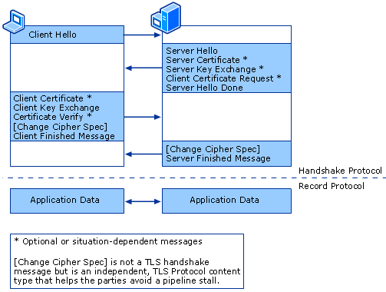
Establishing a Secure Session by Using TLS

Slide 59
Resuming a Secure Session by Using TLS
The client sends a "Client hello" message using the Session ID of the session to be resumed.
The server checks its session cache for a matching Session ID. If a match is found, and the server is able to resume the session, it sends a "Server hello" message with the Session ID.
Note If a session ID match is not found, the server generates a new session ID and the TLS client and server perform a full handshake.
Client and server must exchange "Change cipher spec" messages and send "Client finished" and "Server finished" messages.
Client and server can now resume application data exchange over the secure channel.

Slide 60
TLS Record Protocol
The Transport Layer Security (TLS) Record protocol secures application data using the keys created during the Handshake. The Record Protocol is responsible for securing application data and verifying its integrity and origin. It manages the following:
Dividing outgoing messages into manageable blocks, and reassembling incoming messages.
Compressing outgoing blocks and decompressing incoming blocks (optional).
Applying a Message Authentication Code (MAC) to outgoing messages, and verifying incoming messages using the MAC.
Encrypting outgoing messages and decrypting incoming messages.
When the Record Protocol is complete, the outgoing encrypted data is passed down to the Transmission Control Protocol (TCP) layer for transport.

Slide 61
Message Authentication Codes in SChannel
A Message Authentication Code (MAC) is used to detect message tampering and forgery. The sender of a message creates a MAC by encrypting a one-way hash of the message body using a session key shared by sender and recipient. The MAC is appended to the message that is sent to the recipient. The message recipient generates the MAC again, using the shared session key and message body, and compares the generated MAC to the MAC received from the sender. If the two are identical, then the sender must have the shared session key, and the message has not been altered in transit.
In Schannel protocols, the algorithm used to generate the MAC is determined by the cipher suite in use by the sender and recipient.

Slide 62
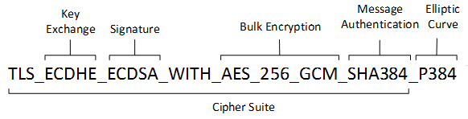
Cipher Suites in TLS
A cipher suite is a set of cryptographic algorithms. The schannel SSP implementation of the TLS/SSL protocols use algorithms from a cipher suite to create keys and encrypt information. A cipher suite specifies one algorithm for each of the following tasks:
Key exchange
protect information required to create shared keys. These algorithms are asymmetric (public key algorithms) and perform well for relatively small amounts of data.
Bulk encryption
Bulk encryption algorithms encrypt messages exchanged between clients and servers. These algorithms are symmetric and perform well for large amounts of data.
Message authentication
Message authentication algorithms generate message hashes and signatures that ensure the integrity of a message.

Slide 63
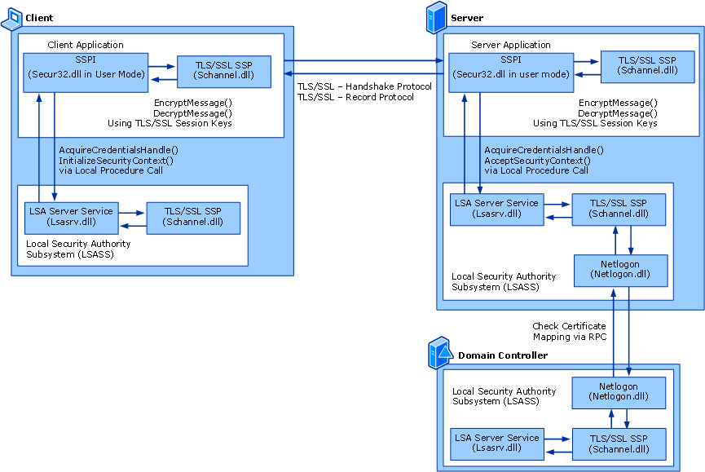
SChannel Architecture
SChannel is a SSP/AP package for LSASS
It’s an hybrid package, existing both in the application and LSA memory space
LSA Mode handles the negotiation process
User Mode handles encryption/decryption of application data
SChannel supports signing users with a certificate and, consequently, may require some services from Active Directory.

Slide 64
Managing SChannel Cipher Suites
Windows provides two registry locations for controlling available algorithms and suites
Legacy Location (inherited from SChannel implementations before CryptNG)
HKEY_LOCAL_MACHINE\SYSTEM\CurrentControlSet\Control\SecurityProviders\SCHANNEL
CryptNG Locations
Local configuration HKEY_LOCAL_MACHINE\SYSTEM\CurrentControlSet\Control\Cryptography\Configuration\Local\SSL
Domain Configuration HKEY_LOCAL_MACHINE\SYSTEM\CurrentControlSet\Control\Cryptography\Configuration\Domain\SSL

Slide 65
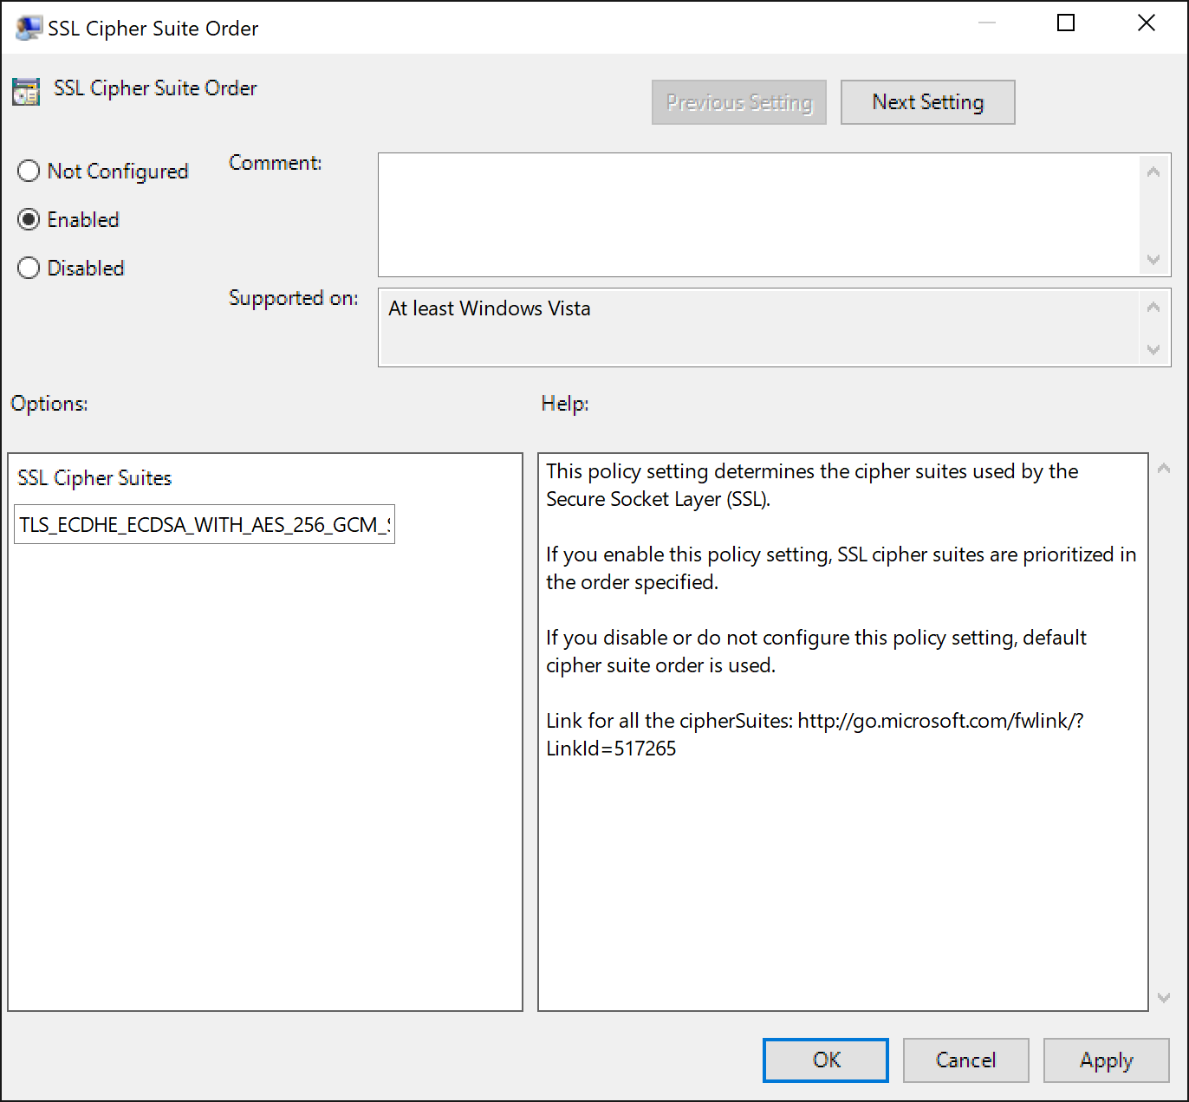
Configuring Cipher suites (preferred way)
Registry entry
HKEY_LOCAL_MACHINE\SYSTEM\CurrentControlSet\Control\Cryptography\Configuration\Local\SSL\00010002\Functions
Available as a GPO setting (domain or local)
GPO should be preferred instead of manual editiong of the registry value

Slide 66
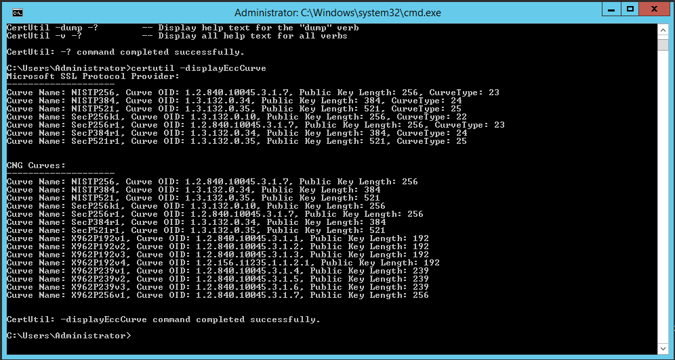
Configuring supported ECC curves (preferred way)
Registry entry
HKEY_LOCAL_MACHINE\SYSTEM\CurrentControlSet\Control\Cryptography\Configuration\Local\SSL\00010002\EccCurves
Configuration done with certutil.exe
certutil should be preferred instead of manual editiong of the registry value
certutil.exe -displayEccCurve
certutil.exe -addEccCurve curveName curveParameters [curveOID] [curveType]

Slide 67
SChannel Legacy protocol configuration
SCHANNEL\Protocols subkey
SCHANNEL\Protocols\SSL 3.0\Client
SCHANNEL\Protocols\SSL 3.0\Server
SCHANNEL\Protocols\TLS 1.0\Client
SCHANNEL\Protocols\TLS 1.0\Server
SCHANNEL\Protocols\TLS 1.1\Client
SCHANNEL\Protocols\TLS 1.1\Server
SCHANNEL\Protocols\TLS 1.2\Client
SCHANNEL\Protocols\TLS 1.2\Server
Values for each subkey
Enabled – type : DWORD: 0 to disable 0x1 to enable.
DisabledByDefault – type DWORD: To enable the system to use the protocols that will not be negotiated by default, change to 0

Slide 68
SChannel Legacy Ciphers configuration
SCHANNEL\Ciphers subkeys
SCHANNEL\Ciphers\RC4 128/128
SCHANNEL\Ciphers\Triple DES 168
SCHANNEL\Ciphers\RC2 128/128
SCHANNEL\Ciphers\RC4 64/128
SCHANNEL\Ciphers\RC4 56/128
SCHANNEL\Ciphers\RC2 56/128
SCHANNEL\Ciphers\NULL
Values for each subkey
Enabled – type : DWORD: 0 to disable 0xFFFFFFFF to enable.

Slide 69
SChannel Legacy Hash algorithm configuration
SCHANNEL/Hashes subkeys
SCHANNEL\Hashes\MD5
SCHANNEL\Hashes\SHA
SCHANNEL\Hashes\SHA256
SCHANNEL\Hashes\SHA384
SCHANNEL\Hashes\SHA512
Values for each subkey
Enabled – type : DWORD: 0 to disable 0xFFFFFFFF to enable.

Slide 70
SChannel Legacy Key Exchange Algorithm configuration
SCHANNEL\KeyExchangeAlgorithms subkeys
SCHANNEL\KeyExchangeAlgorithms\PKCS
Aka. RSA key exchange
SCHANNEL\KeyExchangeAlgorithms\Diffie-Hellman
SCHANNEL\KeyExchangeAlgorithms\ecdh
Values for each subkey
Enabled – type : DWORD: 0 to disable 0xFFFFFFFF to enable.
ClientMinKeyBitLength – type DWORD: Minimum key length in bits supported on client
ClientMaxKeyBitLength – type DWORD: Maximum key length in bits supported on client
ServerMinKeyBitLength – type DWORD: Minimum key length in bits supported on server

Slide 71
SMB Encryption

Slide 72
Server Message Block
Server Message Block (SMB)
Also known as Common Internet File System (CIFS)
Mainly used for providing shared access to files and printers. It also provides an authenticated inter-process communication mechanism
Corresponding Windows services
LAN Manager Server (for server component)
LAN Manager Workstation (for client component)

Slide 73
SMB Transport
Directly over TCP, port 445
Via the NetBIOS API (legacy)
which in turn can run on several transports
On UDP ports 137, 138 & TCP ports 137, 139 (NetBIOS over TCP/IP)
On several legacy protocols such as IPX/SPX

Slide 74
SMB History
SMB 1
Original implementation. Designed by IBM. ~1990
SMB 2.0.2
Windows Vista (2006): Less commands, better performance, improved message signing with HMAC SHA-256 algorithm
SMB 2.1
Windows 7/Server 2008 R2
SMB 3.0
Windows 8/Server 2012: SMB Encryption, SMB Multichannel, SMB Direct
SMB 3.0.2
Windows 8.1/Server 2012 R2
SMB 3.1.1
Windows 10/Server 2016: AES 128 GCM encryption in addition to AES 128 CCM encryption added in SMB3; pre-authentication integrity check using SHA-512 hash

Slide 75
SMB Security
Deprecating SMB1
Crypto algorithms in SMB
Session Keys
SMB Message Integrity
SMB Encryption

Slide 76
Deprecating SMB 1
Microsoft has been asking the world to stop using the legacy SMBv1
Recently, US-CERT issued a security bulletin advising to disable SMBv1 and move to SMB 2.x or preferably SMB 3.x
Windows XP and Windows 2003 have SMBv1 only.
Windows XP support ended on April 8, 2014.
Windows Server 2003 extended support ended on July 14, 2015.

Slide 77
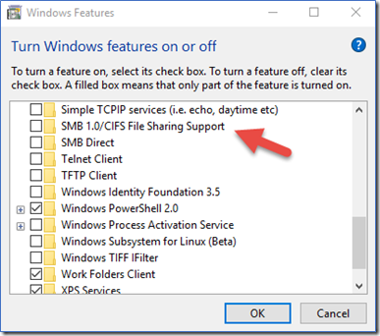
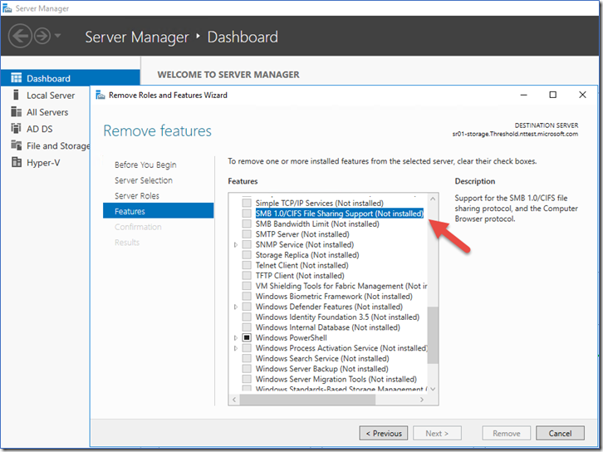
Disable SMB 1 support
Windows client
Windows Server

Slide 78
Disable SMB 1 through registry
To enable or disable SMBv1 on the SMB server, configure the following registry key:
Registry subkey: HKEY_LOCAL_MACHINE\SYSTEM\CurrentControlSet\Services\LanmanServer\Parameters Registry entry: SMB1 REG_DWORD: 0 = Disabled REG_DWORD: 1 = Enabled Default: 1 = Enabled (No registry key is created)
To enable or disable SMBv2 on the SMB server, configure the following registry key:
Registry subkey:HKEY_LOCAL_MACHINE\SYSTEM\CurrentControlSet\Services\LanmanServer\Parameters Registry entry: SMB2 REG_DWORD: 0 = Disabled REG_DWORD: 1 = Enabled Default: 1 = Enabled (No registry key is created)
Note You must restart the computer after you make these changes

Slide 79
Disable SMB 1 through registry
To enable or disable SMBv1 on the SMB client, configure the following registry key:
Registry subkey: HKEY_LOCAL_MACHINE\SYSTEM\CurrentControlSet\services\mrxsmb10 Registry entry: Start REG_DWORD: 4 = Disabled
MRxSMB10 needs to be removed from the entry for LanmanWorkstation so that it can start normally without requiring MRxSMB10 to first start.
Registry subkey:HKEY_LOCAL_MACHINE\SYSTEM\CurrentControlSet\Services\LanmanWorkstation Registry entry: DependOnService REG_MULTI_SZ: “Browser”,”MRxSmb20″,”NSI”
Note You must restart the computer after you make these changes

Slide 80
Chronology of crypto algorithms in SMB
Dialect | Key derivation | Signing | Encryption
2.0.2 | GSS-API SessionKey | HMAC-SHA256 | None
2.1 | GSS-API SessionKey | HMAC-SHA256 | None
3.0 | GSS-API SessionKey & KDF [SP800-108] | AES-128-CMAC | AES-128-CCM
3.0.2 | GSS-API SessionKey & KDF [SP800-108] | AES-128-CMAC | AES-128-CCM
3.1.1 | SHA-512 & GSS-API SessionKey & KDF [SP800-108] | AES-128-CMAC | AES-128-CCM and AES-128-GCM

Slide 81
Session Keys
All cryptographic keys used in SMB 2.x and 3.x are derived from the SessionKey
The security of SMB 2/3 signing and encryption relies in part on the session key.
Session Key: the first 16 bytes of the cryptographic key queried from the GSS protocol (e.g. Kerberos, NTLM) for this authenticated context
If the cryptographic key is less than 16 bytes, it is right-padded with zero bytes
In SSPI (Microsoft’s implementation of GSS-API), the session key is extracted by using QueryContextAttributes with SECPKG_ATTR_SESSION_KEY

Slide 82
NTLM Session Key
In NTLM security provider, the SessionKey is the ExportedSessionKey described in MS-NLMP. NTLM is a challenge response protocol and its session key is based on password hashing that relies on weak cryptography.
NTLM does not support any modern cryptographic methods, such as AES or SHA-256. Its key derivation from the password is based on MD4 [RFC1320], DES [FIPS46-2], HMAC_MD5, and RC4.
NTLM does not use any salt. It is possible to observe a network packet trace and produce the same key if the attacker knows password, as shown in the appendix by an example of NTLMv2 session key calculation.
NTLM does not offer mutual authentication between client and server. The is no so such flag in the protocol.
The password length and complexity should be chosen carefully to mitigate brute force attacks.
At a minimum, NTLMv2 should be used, and auditing should be in place.

Slide 83
Kerberos Session Key
In Kerberos [RFC4120] security provider, the SessionKey is either
the sub-session key (subkey) if it was negotiated during KRB_AP_REQ/KRB_AP_REP exchange
or the session key from the ticket if no subkey was negotiated.
When the KDC issues a service ticket, it generates a random session key.
The KDC issues tickets with the strongest encryption type (etype) to protect the session key. The etype is based on configuration of what the KDC enforces and what client and server principals can support (AES256_HMAC_SHA1, AES128_HMAC_SHA1, RC4_HMAC_MD5, DES_CBC_MD5, DES_CBC_CRC).

Slide 84
SMB Message Integrity
Signed Session
On a signed session, every signed packet includes a signature that the receiver can validate.
Unlike SMB1 signing which uses MD5 as hashing algorithm, SMB2 uses a better hashing for signing. SMB 2.02 and SMB 2.1 use HMAC SHA-256, whereas SMB 3.0 upgrades to AES-128-CMAC for its signing.
Before signing can happen, the client and server need to negotiate signing; and the client needs authenticate first to have a SessionKey from which a SigningKey is derived (more details on this later). SMB 2.x did not have a mechanism to detect MITM downgrading of negotiated capabilities.

Slide 85
SMB Message Integrity
Secure dialect negotiation in SMB 3.0.x
Dialect 3.0 implements secure dialect negotiation (SMB 3.0, 3.02) to protect against security-downgrade attacks. When SMB 3.0 is negotiated, the client must send a mandatory signed request to validate the Negotiate information. The validation occurs post-authentication and after the Tree Connect exchange
Pre-authentication integrity in SMB 3.1.1
SMB 3.1.1 pre-authentication integrity enhances protection against security-downgrade attacks by verifying the integrity of all messages preceding the session establishment. This mandatory feature protects against any tampering with Negotiate and Session Setup. Pre-authentication integrity also integrates a salt transmitted on the wire as part of the hash calculation. The pre-auth-integrity negotiate context has a salt of 32 bytes. The salt is randomly generated (e.g. PRNG) and not reused

Slide 86
SMB Signing Configuration
By default, Windows client and server have the following settings.
Get-SmbClientConfiguration | fl EnableSecuritySignature,RequireSecuritySignature
EnableSecuritySignature : True
RequireSecuritySignature : False
The corresponding registry keys on the client are under HKLM\SYSTEM\CurrentControlSet\Services\LanmanWorkstation\Parameters
Get-SmbServerConfiguration | fl EnableSecuritySignature,RequireSecuritySignature
EnableSecuritySignature : False
RequireSecuritySignature : False
The corresponding registry keys on the server are under HKLM\SYSTEM\CurrentControlSet\Services\LanmanServer\Parameters

Slide 87
Requiring Signing
The session will have Signing Required if one the following conditions is met:
Signing has been required by negotiation
The server configuration requires message signing
The SessionSetup requires signing
NOTE: Signing cannot be required for guest or anonymous sessions as they do not have proper security context.

Slide 88
SMB Encryption
Encryption negotiation in SMB 3.0
SMB 3.0.x client and server advertise encryption support a capability flag during the NEGOTIATE phase
If encryption is enforced on the whole server, each session enables encryption by setting a flag in the SessionSetup response
For a per-share enabled encryption a flag in the TreeConnect response sets the encryption
SMB 3.0 and SMB 3.0.2 support only the encryption algorithm AES-128-CCM
Encryption negotiation in SMB 3.1.1
SMB 3.1.1 client and server negotiate encryption support by exchanging supported cipher IDs for AES-128-GCM and AES-128-CCM during the NEGOTIATE phase

Slide 89
SMB Encryption configuration
The configuration items that affect encryption on Windows 8 / Windows Server 2012 and onward are:
Global level encryption on the server:
Set-SmbServerConfiguration -EncryptData <0|1>
Share level encryption:
New-SmbShare -Name <share name> -Path <pathname> -EncryptData 1
Set-SmbShare -Name <share name> -EncryptData <0|1>
Server-wide encryption has precedence over share level encryption. If global encryption is enabled, you cannot selectively disable encryption for certain shares.

Slide 90
Wrapping up
In SMB 2.0.2 and 2.1 dialects:
Message integrity across an authenticated session.
In SMB 3.0 dialect:
Message integrity (with a stronger algorithm) across an authenticated session.
Encryption of traffic between client and server.
Session binding to multiple connections (multichannel).
Validation of negotiated information.
In SMB 3.1.1 dialect:
All the above 3.0 dialect security features, except the validation of negotiated information.
Negotiation of encryption and integrity algorithms.
Protection of negotiation and session establishment.

Slide 91
.
Part 3 – Public Key Infrastructure
Learning Objectives
Understand the basic building blocks around digital certificates and public key infrastructures

Slide 92
Certificates

Slide 93
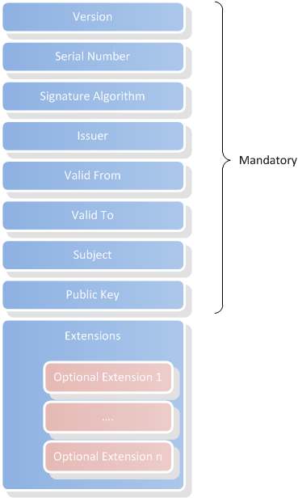
X.509v3 Certificates Logical Structure
8 mandatory attributes
Version : set to 3
Serial Number : binary value chosen by the Issuer
Signature Algorithm : Unique identifier of the scheme used to sign the certificate
Issuer : Distinguished name of the Issuer
Valid From : The certificate is only valid passed this date
Valid To: The certificate is valid until this date
Subject: Distinguished name of the identity represented by the certificate
Public Key: Public cryptographic material
A variable list of extensions

Slide 94
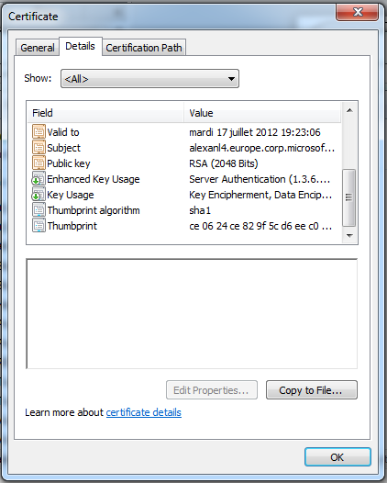
Viewing Content of X.509 Certificates
Mandatory attributes are drawn with an orange icon
Optional extensions are drawn with a green arrow or a yellow excl. mark
Properties are drawn with a simple icon. Properties are not part of the certificate

Slide 95
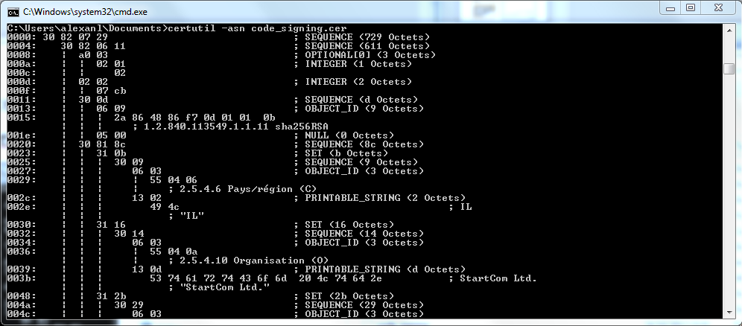
X.509 Certificates physical structure
Certificates are encoded using the ASN.1 language
Certutil.exe -asn file.cer to dump the ASN.1 structure

Slide 96
Reminder
Private keys are never stored in the certificates
Windows use two different storing architectures for certificates and private keys
Certificate Stores : store certificates
Key containers : store private keys
Key containers are of two sorts:
Software key containers : keys are stored on the computer and are protected by software
Hardware key containers : key are stored on dedicated devices like Smartcards or HSM. They usually can’t be extracted from these devices

Slide 97
Public Key Infrastructure

Slide 98
X.509 Certificates Handling issues
One certificate = One identity
To verify data protected by one certificate, one must have the public key to verify the certificate signature
How to handle 100 000 000 identities ?
How to distribute public keys ?

Slide 99
About trust
Trust is about extending the confidence scope
Example of trusts in cryptography
Trusting a peer to send sensitive data
Trusting a peer for digitally signed content
Trust implies knowledge of pre-shared data
X.509 certificate for S/MIME
PGP key
Pre-Shared key for home WiFi network
The trust relationship must be established before exchanging data.

Slide 100
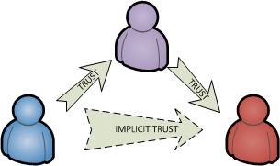
Trust Chains
Trusts are transitive
If A trust B and B trusts C, then A trusts C
Introducing “Trusted Third Party”

Slide 101
Certificates Authorities
Certificate Authorities are like “trust aggregators” or third-party trust.
Previously learned scheme : A trust B because A know B’s certificate ;
With a CA, a new intermediate is introduced: A trusts the CA because A knows the CA’s certificate; then the CA trusts B because it signed B’s certificate; so, A trusts B
Many level of CA can be specified. Usually 3

Slide 102
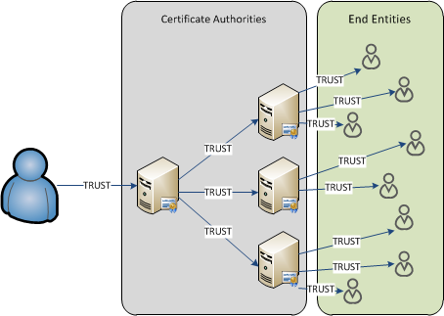
Trust Aggregation

Slide 103
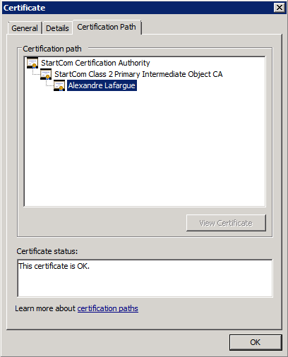
Examining the trust chain
With the Certificate GUI

Slide 104
Examining the trust chain
certutil.exe -verify certificate_file.cer
CertContext[0][0]: dwInfoStatus=102 dwErrorStatus=0
Issuer: CN=StartCom Class 2 Primary Intermediate Object CA, OU=Secure Digital Certificate Signing, O=StartCom Ltd., C=IL
Subject: E=user@contoso.com, CN=User, L=SEATLE, S=WA, C=US
CertContext[0][1]: dwInfoStatus=102 dwErrorStatus=0
Issuer: CN=StartCom Certification Authority, OU=Secure Digital Certificate Signing, O=StartCom Ltd., C=IL
Subject: CN=StartCom Class 2 Primary Intermediate Object CA, OU=Secure Digital Certificate Signing, O=StartCom Ltd., C=IL
CertContext[0][2]: dwInfoStatus=10c dwErrorStatus=0
Issuer: CN=StartCom Certification Authority, OU=Secure Digital Certificate Signing, O=StartCom Ltd., C=IL
Subject: CN=StartCom Certification Authority, OU=Secure Digital Certificate Signing, O=StartCom Ltd., C=IL

Slide 105
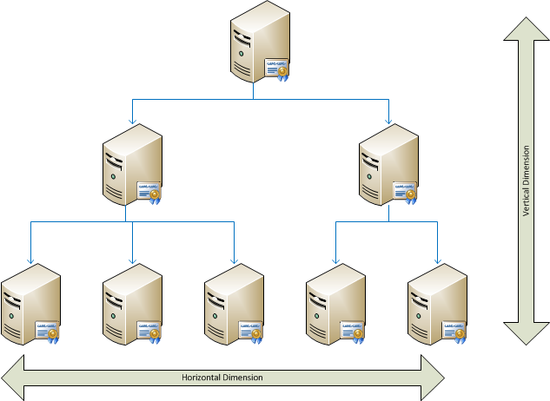
Two-dimension design
Vertical : How many authority level ?
Horizontal : How many authority in each level ?
PKI Levels
Root level: Always one root CA
Leaf level : Usually 1 or mode Issuing CA to issue certificates to users and computers
Plan for multiple CA in a given level
Depends on security policy
Depends on required availability
Depends on certificate usage in the architecture

Slide 106
Certificate Enrollment

Slide 107
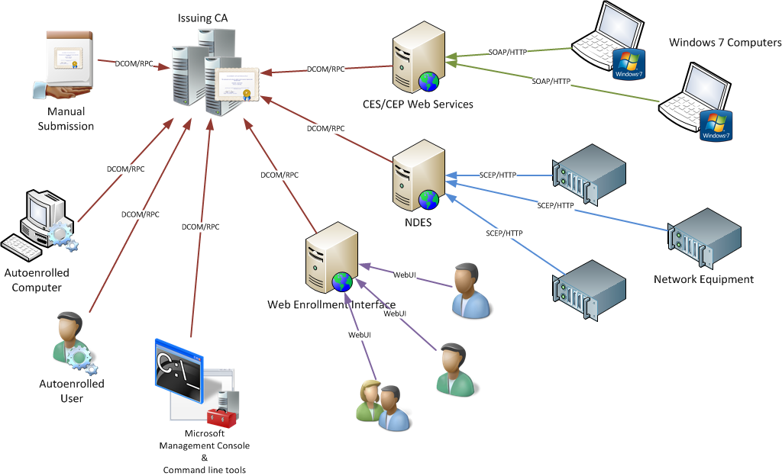
Certificate Issuance Endpoints
Several enrollment protocols to accommodate usages

Slide 108
Certificate Revocation

Slide 109
Introducing Revocation
A digital certificate identity is valid until it expires
Need a way to handle real life events like key compromising, employee leaves, stolen laptops ….
Revocation is performed when a certificate identity has to be invalid before the end of the validity period
Certificate revocation:
Can be postponed to a given time
Can be attached to a reason.
The issuing CA must keep a list of revoked certificates

Slide 110
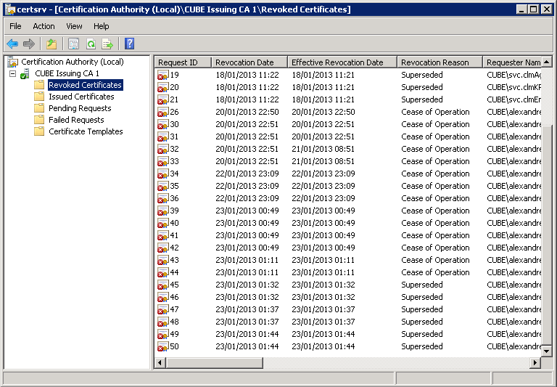
Displaying Revoked certificates

Slide 111
Certificate Revocation Publishing
CRL – Certificate Revocation List
Just a list of revoked certificate. This list is signed with the CA certificate
Published at regular interval (1 week, 1 day, 4 hour). So, not realtime.
Exist in two flavor
BaseCRL : all revoked certificates
DeltaCRL : all revoked certificate which are not present in the current BaseCRL
OCSP – Online Certificate Status Protocol
Client-Server protocol to ask the current status of a given certificate
Relies on HTTP

Slide 112
Downloading CRL objects
File protocol By default, the FILE protocol is disabled for network retrieval of PKI objects. The FILE protocol can be enabled by modifying the registry.
HTTP Anonymous access. The public key infrastructure (PKI) client performs authentication only to locally configured proxies. By default, authentication is only performed when the proxy server returns an error message that proxy authentication is required.
LDAP Can use any LDAPv3 compliant directory.

Slide 113
Certificate Chain Validation
All possible certificate chains are built using locally cached certificates. If none of the certificate chains ends in a self-signed certificate, CryptoAPI then selects the best possible chain and attempt to retrieve issuer certificates specified in the authority information access extension to complete the chain. This process is repeated until a chain to a self-signed certificate is built.
For each chain that ends in a self-signed certificate in the trusted root store, revocation checking is performed.
Revocation checking is performed from the root CA certificate down to the evaluated certificate.

Slide 114
Chain Building
CryptoAPI attempts to build all possible certificate chains. Certificate will be collected from the following locations
Certificates provided by the application.
The set of certificates already cached in memory by the certificate validation engine (Crypt32.dll). Each process that uses Crypt32.dll may have one or more certificate validations executing, each with its own separate state and memory cache.
Local certificate stores including Group Policy. Certificates that are manually installed into the Trusted Root and Intermediate certificate stores (including those downloaded by Group Policy) can be used to build a certificate chain.
Certificates stored in the local disk cache by CryptoAPI.
Network Retrieval from locations specified in the authority information access extension. The URLs are only used if CryptoAPI cannot build a single chain that chains to a self-signed certificate from the previously mentioned certificate locations.

Slide 115
Certificate Validation
After CryptoAPI starts validating the individual certificates in the presented certificate chain(s), the following checks are performed
CryptoAPI determines whether the certificate is included in the Untrusted certificate store. All certificates in the Untrusted certificate store are explicitly designated as disallowed certificates.
If the certificate included a stapled OCSP response and the stapled response is time valid, use the stapled OCSP response to valid the revocation status of the certificate.
If a CRL with the matching issuer name and optionally the same IDP is already in the CA store, use that version of the CRL.
If a stapled response or previously downloaded CRL is not available, then CryptoAPI must attempt URL retrieval to determine the revocation status of the certificate.
The URLs for OCSP and CDP are built in the following order:
OCSP URLs from Group Policy
OCSP URLs from the authority information access extension
CRL URLs from the CDP extension

